Slide 1





















SwarmGenomics Repeat analysis
ATGCTTCGCGAACGTACGTCGCGAACATTATGCTTCGCGAACGTACGTACGTAGGT

Slide 2
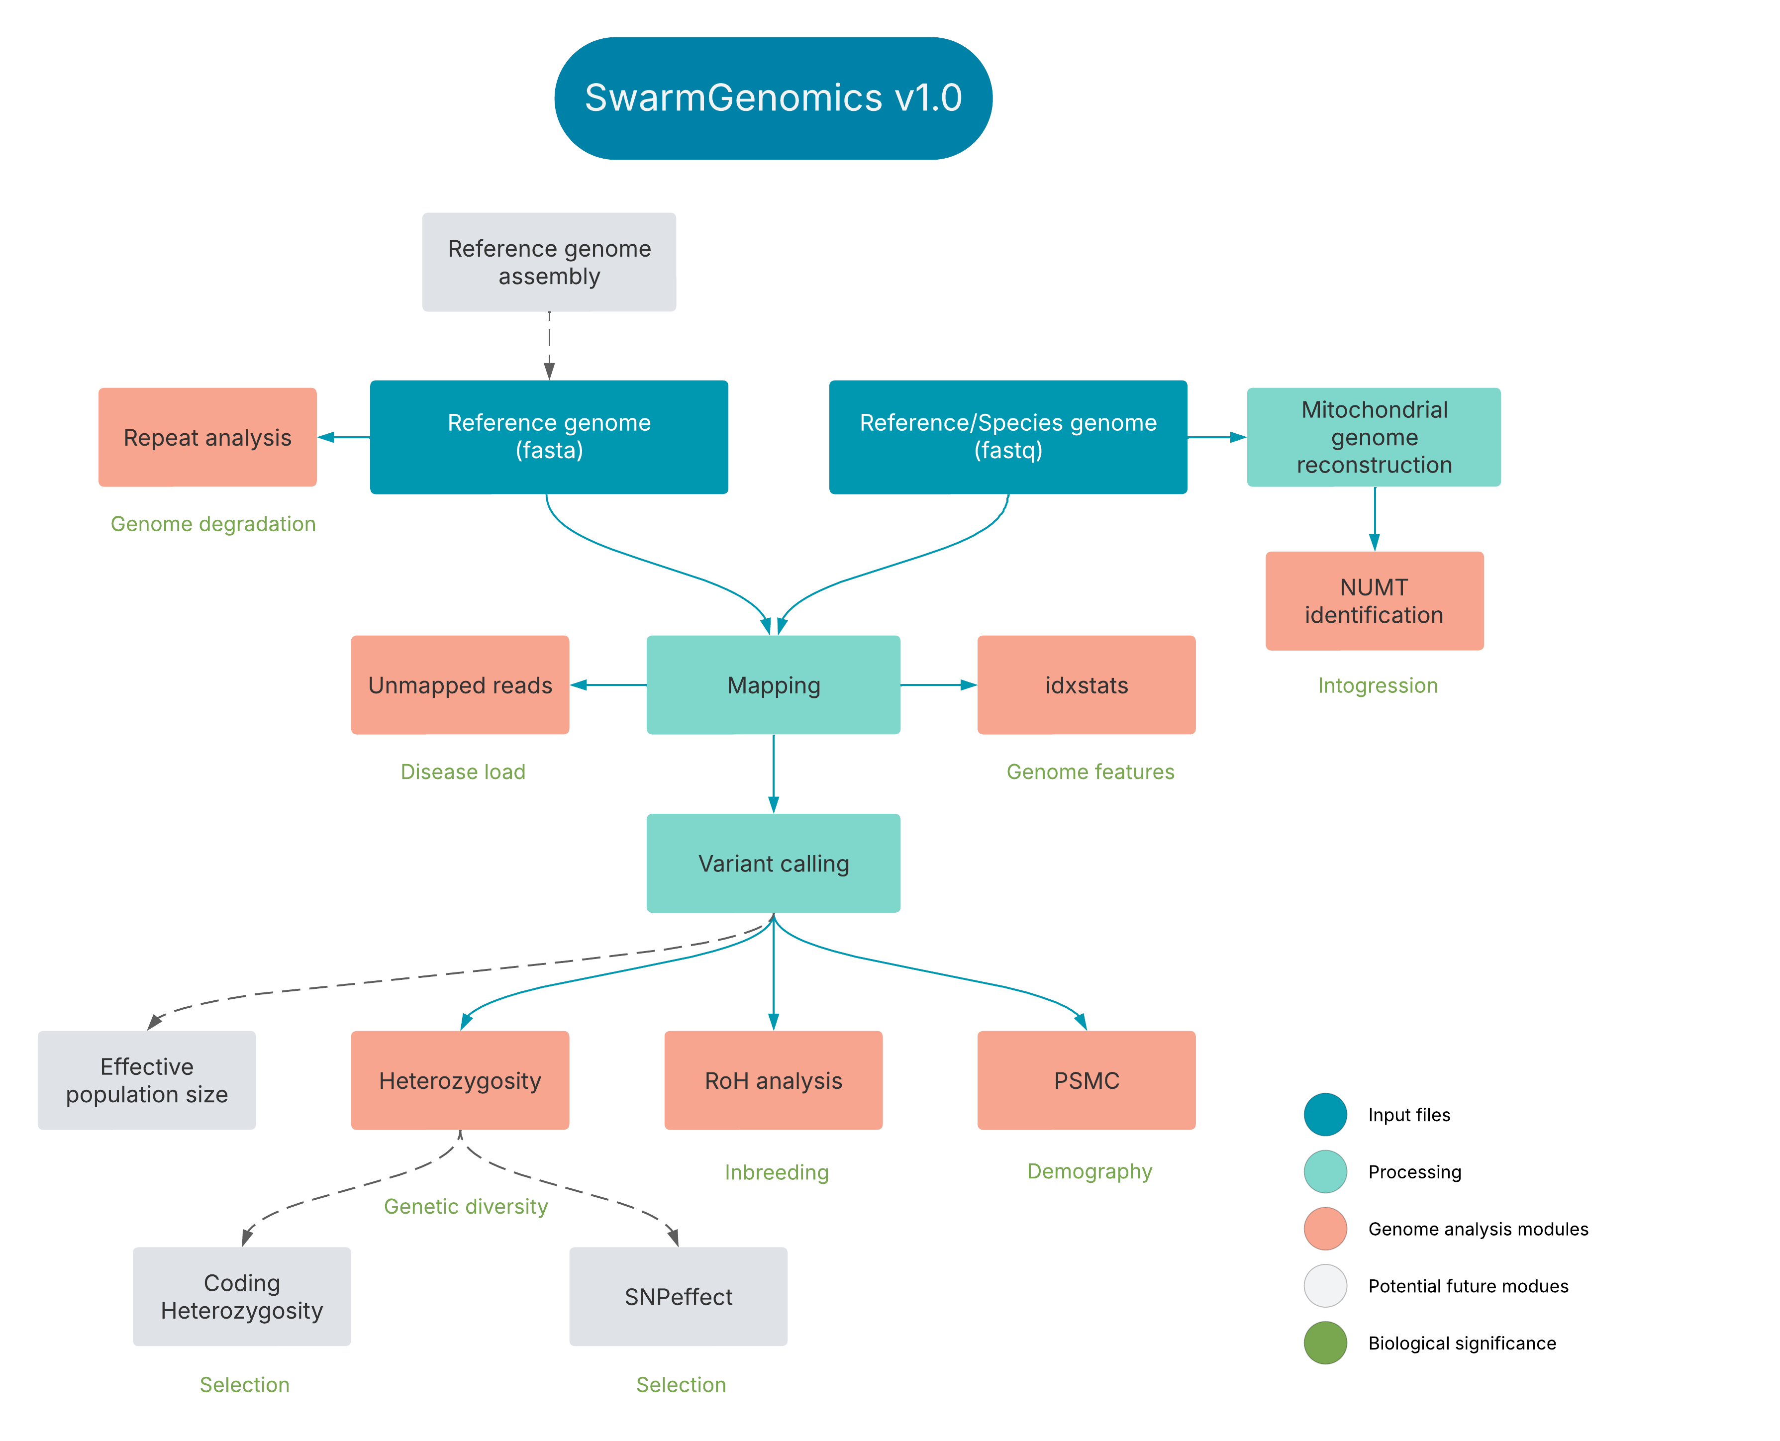

Slide 3
Background – Transposable Elements = “Jumping Genes”
Genome architecture: create mutations, duplications, deletions
Regulation: influence gene expression and epigenetics
Evolution: raw material for innovation, gene shuffling
Disease: insertions can disrupt genes or cause instability
Species | Genome Size (approx.) | % Repeats/TEs
Human | ~3.2 Gb | ~45% TEs
Maize (corn) | ~2.3 Gb | >85% TEs
Fruit fly (Drosophila) | ~180 Mb | ~10–15% TEs
Pufferfish (Fugu) | ~400 Mb | ~10% TEs

Slide 4
Background – Classification
Class I – Retrotransposons (Copy & Paste)
Move via RNA intermediate → reverse transcribed to DANN
Subtypes:
LTR (Long Terminal Repeat): e.g., Ty1/copia, gypsy
Non-LTR:
LINEs (Long Interspersed Nuclear Elements)
SINEs (Short Interspersed Nuclear Elements)
Class II – DNA Transposons (Cut & Paste)
Move directly as DNA via transposase enzyme
Often flanked by Terminal Inverted Repeats (TIRs)
Examples: Tc1/mariner, hAT, Mutator

Slide 5
Background – Examples
Corn
DNA Transposons
Ds inserts into a pigment gene, it disrupts pigment production, causing colorless kernels
If Ds jumps out during kernel development, pigment is restored in some cells, resulting in spotted or variegated kernels
Hemophilia A
Retrotransposon
Disease caused by a LINE-1 insertion into the F8 gene on the X chromosome
A new L1 element inserted into exon 14 of the F8 gene, disrupting the gene's function
Leads to a nonfunctional factor VIII protein, causing spontaneous bleeding and clotting issues

Slide 6
Repeat analysis
https://github.com/AureKylmanen/Swarmgenomics/blob/main/10.%20Repeat%20Analysis.md

Slide 7
Running Repeat Analysis
Download RepeatAnnotator.bash and edit in a text editor

Slide 8
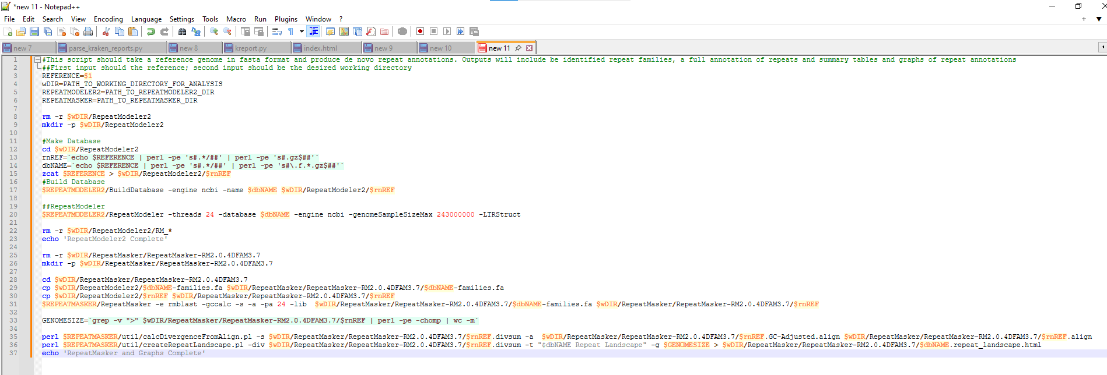
Running Repeat Analysis – edit script in Notepad or Terminal
REFERENCE="/vol/storage/swarmgenomics/aurek/giant_panda/acreference.fna.gz"
wDIR="/vol/storage/swarmgenomics/aurek/giant_panda"
REPEATMODELER2="/vol/storage/software/RepeatModeler-2.0.4"
REPEATMASKER="/vol/storage/software/RepeatMasker"
Example:

Slide 9
Running Repeat Analysis – edit script in Notepad or Terminal
vim RepeatAnnotator.bash (to create and edit file)

Slide 10
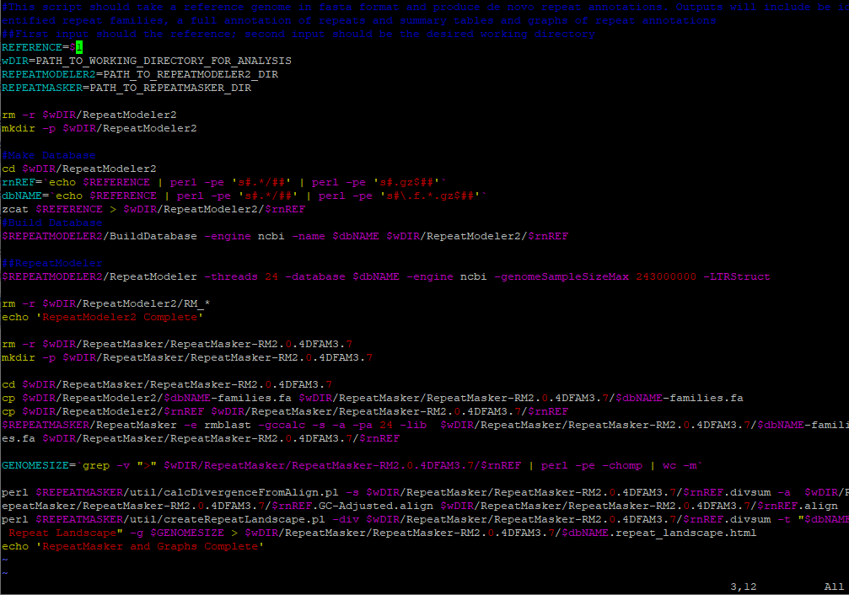

Running Repeat Analysis – edit script in Notepad or Terminal
Paste script (right click)
Click “I” on keyboard to edit (“insert” should appear at the bottom)
Edit the paths
Click “Esc” once finished and type “:wq!” (should appear at the bottom) and click “Enter”

Slide 11
Running Repeat Analysis
Use dos2unix to convert plain text files from DOS/Windows format to Unix/Linux
And chmod +x to make the file executable
To run use nohup and &
Will take 36-72h

Slide 12
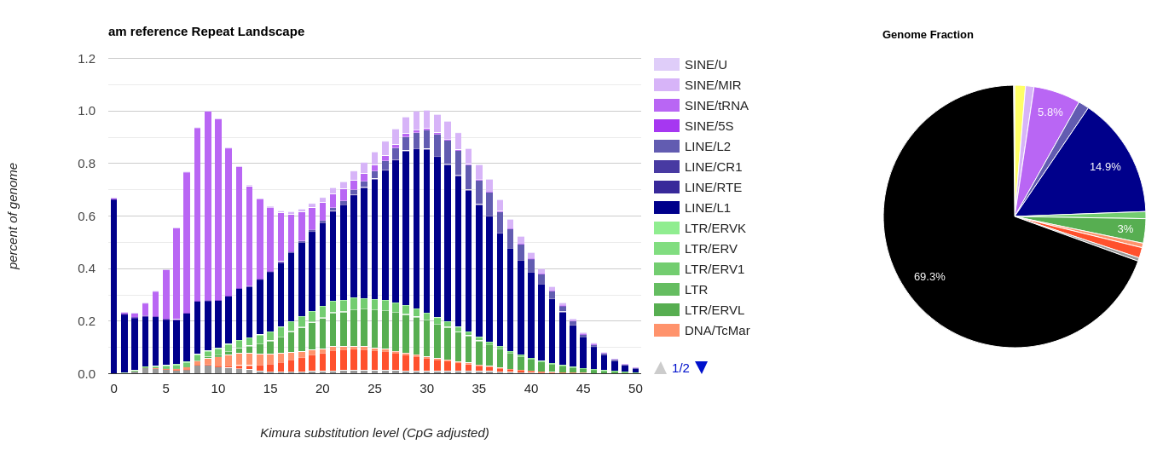
Interpreting the results
Html file with results in RepeatMasker directory, move it to your pc with FileZilla

Slide 13
Interpreting the results
Peak at new repeats = recent expansion = active repeats
Different repeat families
How much of the genome is repeats – here about 30%
Newer
Older
“Age” of the repeats

Slide 14
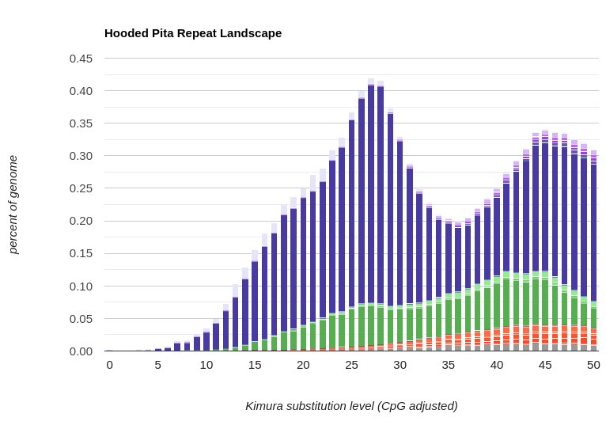
Interpreting the results
No peak = old repeats = no active repeats
Newer
Older
“Age” of the repeats

